Slide 1

ANNAMACHARYA INSTITUTE OF TECHNOLOGY AND SCIENCES (AUTONOMOUS)
SECURE DECENTRALIZED AGGREGATION TO PREVENT MEMBERSHIP PRIVACY LEAKAGE IN EDGE-BASED FEDERATED LEARNING
Under the Guidance of : Presented by:
P. Kavitha Name: K . Lakshmi Sravanthi
Assistant Professor Roll No:23701F0063
Department of MCA

Slide 2
ABSTRACT
Federated Learning is a machine learning approach that combines local models from multiple users to create a global mode1, protecting data privacy. Frequent parameter sharing between users and the aggregator can incur high risk of membership privacy leakage. Proposed Lightweight privacy-preserving scheme using secure decentralized aggregation for edge networks. Effectively protect the membership privacy of both local models and global models. Meanwhile, smart contract is introduced to identify malicious models uploaded by edge nodes and return trustworthy global models to users.

Slide 3
CONTENTS
SDLC methodologies
Waterfall Model
ER-Model
UML Diagrams
Testing and Types of testing
Test Cases
Sample Screens
Conclusion
Introduction
Purpose
Scope
Existing System
Disadvantages
Proposed System
Advantages
Architecture
Modules
Hardware and Software Requirements

Slide 4
INTRODUCTION
Federated Learning is a machine learning approach that combines local models from multiple users to create a global mode1, protecting data privacy Design and develop a secure decentralized aggregation framework: For edge-based federated learning . Edge-based federated learning: Enables multiple edge devices to collaboratively train a shared model without sharing local data. However, frequent parameter sharing between users and the aggregator can incur high risk of membership privacy leakage. LiPFed, a computationally lightweight privacy preserving FL scheme using secure decentralized aggregation for edge networks. Under this scheme, To ensure privacy preservation on the aggregation side, and promote lightweight computation on the user side.

Slide 5
PURPOSE
Proposed LiPFed, a decentralized scheme for edge networks . Which protects the membership privacy of users’ training data. Enables verification through smart contracts on blockchain. Design an Additive Secret Sharing algorithm based on one-time padding to protect local and global models. This algorithm reduces the computational overhead of privacy preservation on the user side, and ensures high usability of the global model without any compromise on accuracy.

Slide 6
SCOPE
Centralized FL vulnerable to membership privacy leakage, Prompts research efforts to develop defensive measures. Recent studies have proposed several privacy preserving FL schemes. as summarized in which mainly resort to three types of privacy preserving techniques, and including Shamir secret sharing, Secure Multy-Party Computation, differential privacy (DP), and homomorphic encryption (HE), model updates can be securely aggregated without exposing sensitive information

Slide 7
EXISTING SYSTEM
Membership inference stands as one of the most severe security threats in FL today. Based on the attacker’s knowledge and access to the target model, membership inference attacks can be classified into two types
White-box attacks: Attacker has complete access to model.
Black-box attacks: Attacker has limited access to model.
Disadvantages
Attacker possesses a shadow dataset similar to private training data
Prone to man-in-the-middle attacks due to inadequate communication encryption.
Vulnerable to data leakage from compromised centralized servers.
Weak identity verification allows unauthorized device sharing.

Slide 8
PROPOSED SYSTEM
LiPFed employs blockchain and cryptographic techniques to ensure secure, private, and accurate Federated Learning.The proposed system leverages blockchain's decentralized nature and cryptographic algorithms to protect user data and prevent malicious activities in Federated Learning. LiPFed combines blockchain, encryption, and differential privacy to create a secure and private Federated Learning framework.
Advantages
Prevents unauthorized access and leakage of sensitive authorization data during device sharing.
Works seamlessly with existing platforms and device-sharing mechanisms without disrupting current services.
Automatically detects and reducing manual intervention and errors.

Slide 9
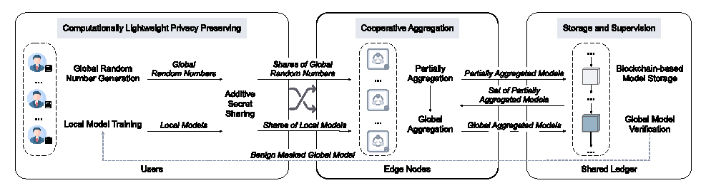
ARCHITECTURE
Computationally Lightweight Privacy Preserving
Cooperative Aggregation
Storage and Supervision

Slide 10
MODULES
Cloud server: The Cloud Server module requires a valid username and password login to access various operations.
User: In this module there are n number of users .Users should register, login and access various document-related operations.
Attacker: The attacker hacks the document through the URL bar. Malicious content is added, and the document's status is updated to "Not Safe".

Slide 11
Functional Requirements And Non-Functional Requirements
Functional Requirements
Functional requirements describe the specific behaviors or functions of a system and delineate the intended actions of the system and can be segmented into various categories such as Inputs, Outputs, Data Storage, Computations
Non-Functional Requirements
Non-Functional requirements (NFRs) address fundamental aspects of software systems, focusing on qualities beyond specific functionalities. Failure to address NFRs adequately can result in user dissatisfaction, software conflicts, and increased time and cost to rectify issues.

Slide 12
Hardware Requirements
System : I3 or I5
Hard Disk : 500 GB
Ram : 4 GB
Operating system : Windows 7
Coding Language : JAVA/J2EE
Tool : Net beans 7.2.1
Database : MYSQL
Software Requirements

Slide 13
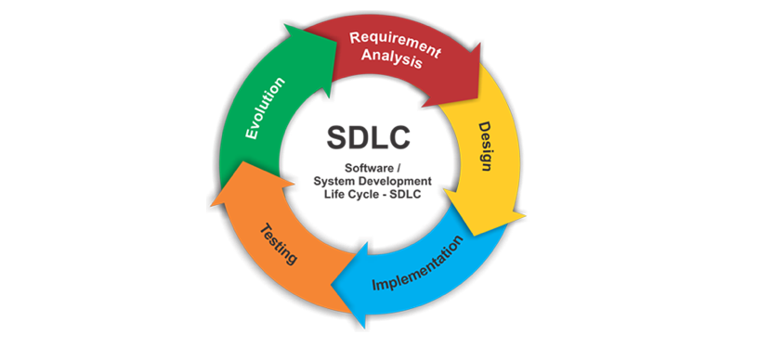
SDLC Methodologies
The Software Development Life Cycle (SDLC) is a structured process for developing software, from understanding requirements to delivering a product. Choosing the right SDLC model is crucial for project success.

Slide 14
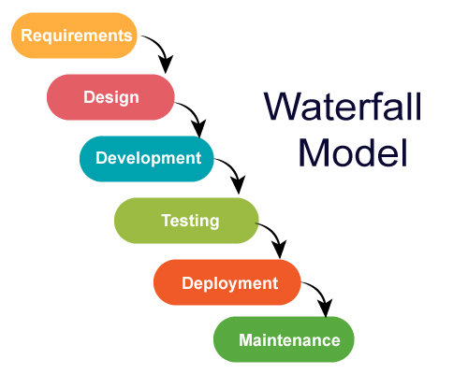
Waterfall Model
The Waterfall Model is a linear, sequential approach to software development, where each stage begins after the previous one is completed, with five stages: analysis, design, implementation, testing, and operation.

Slide 15
ER Diagram
An Entity-Relationship (ER) model illustrates the structure of a database using a visual representation known as an Entity-Relationship Diagram (ER Diagram).

Slide 16
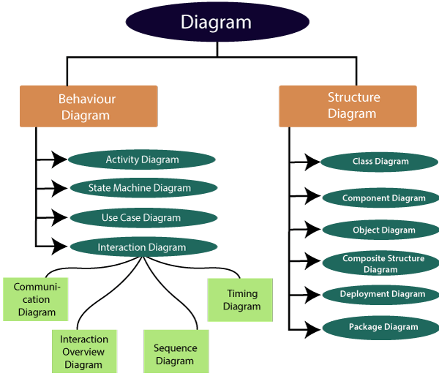
UML Diagrams
UML (Unified Modeling Language) diagrams are graphical representations used to visualize, design, and document software systems, showing different aspects of the system's structure and behavior.

Slide 17
Use case Diagram
A Use Case Diagram shows system functions and the actors who use them.
Login
Upload Files
Check Leakage
Administrator
Share Files
View Files
logout

Slide 18
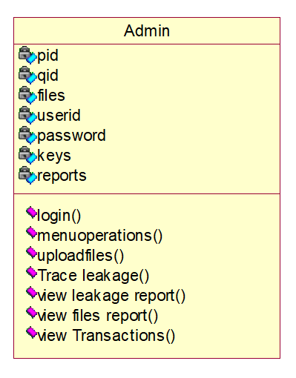
Class Diagram
A UML Class Diagram shows a system's structure, including classes, properties, methods, and relationships, to illustrate how data is organized.

Slide 19
Sequence Diagram
A sequence diagram is a type of interaction diagram that shows the sequence of messages, events, and interactions between objects or components in a system over time.

Slide 20
Collaboration Diagram
A collaboration diagram in UML illustrates how objects or components interact and collaborate to achieve a specific goal or functionality.

Slide 21
Activity Diagram
An activity diagram is a UML behavioural diagram illustrating the flow of activities, actions, and decisions within a system or business process.

Slide 22
Component Diagram
A component diagram is a visual representation of the structural components of a system, showing how they interact and relate to each other, and depicting the high-level architecture of the system.

Slide 23
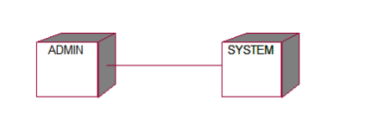
Deployment Diagram
A deployment diagram is a visual representation of the physical architecture of a system, showing how hardware and software components are deployed and configured on physical nodes, such as servers, devices, and networks.

Slide 24
TESTING
Testing is the process of evaluating a software system, application, or product to ensure it meets the required standards, works as expected, and is free from defects or errors.
Types of Testing
1. Unit Testing: Testing individual components or modules of the aggregation algorithm.
2. Integration Testing: Testing how different components or modules interact with each other.
3. System Testing: Testing the entire system, including the aggregation algorithm, edge nodes, and communication protocols.
4. Security Testing: Testing the system's defenses against various attacks, such as data leakage, membership inference, and Byzantine attacks.

Slide 25
Test Cases
A test case is a detailed, documented set of conditions or inputs used to verify that a particular function, feature, or component of a software system operates as expected.
S.NO | Test Cases | Input | Expected Result | Actual Result | Status
1 | User Registration | Enter all fields | User gets registered | Registration is successful | pass
2 | User Registration | if user miss any field | User not registered | Registration is un successful | fail
3 | Admin Login | Give the user name and password | Admin home page should be opened | Admin home Page has been opened | Pass
4 | Upload files | A file will be uploaded | Files will be uploaded to cloud server | File to be uploaded | pass
5 | Find Leakage | Leakage Checking | If any leakage of user files are there it will traced | Trace leakage of user | pass

Slide 26
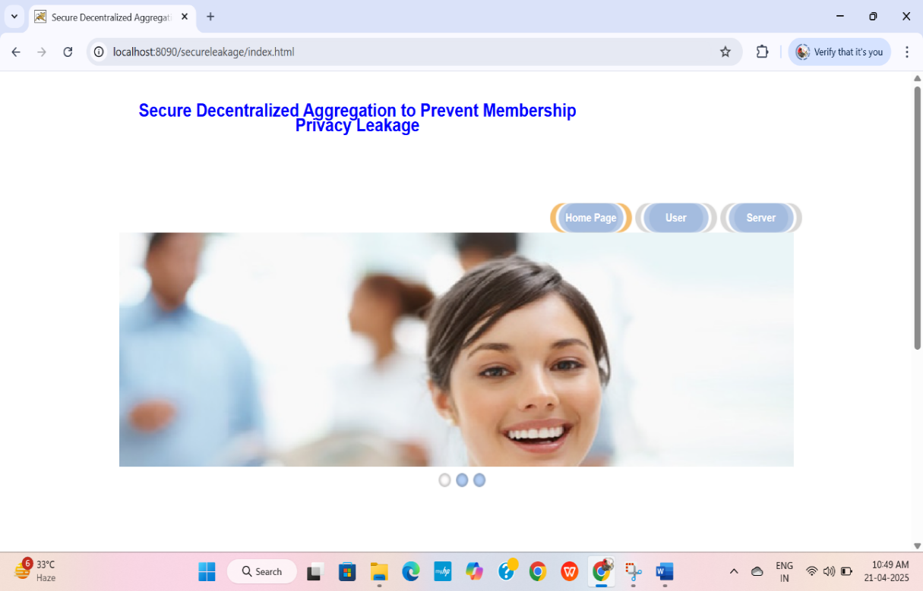
Sample Screens
Home Page

Slide 27
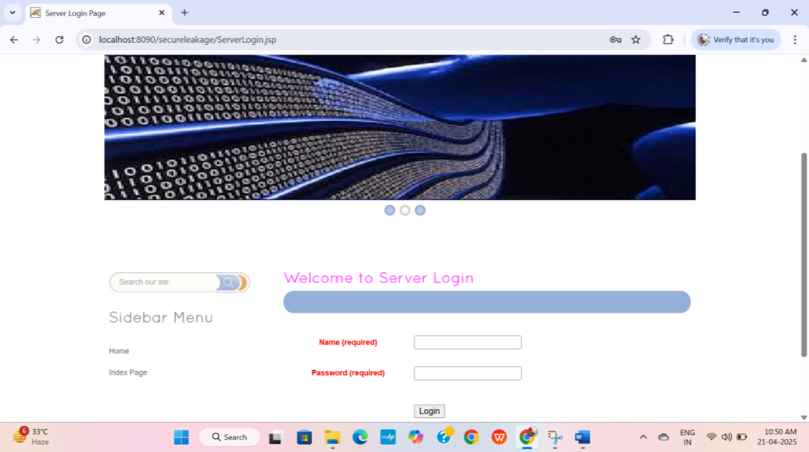
Server Login Page

Slide 28
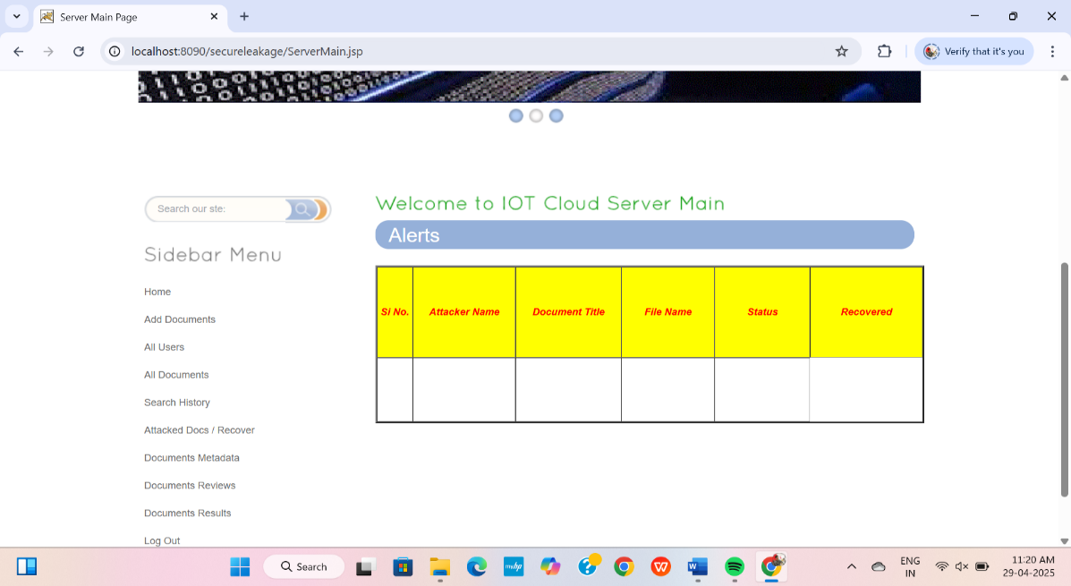
Server Main Page

Slide 29
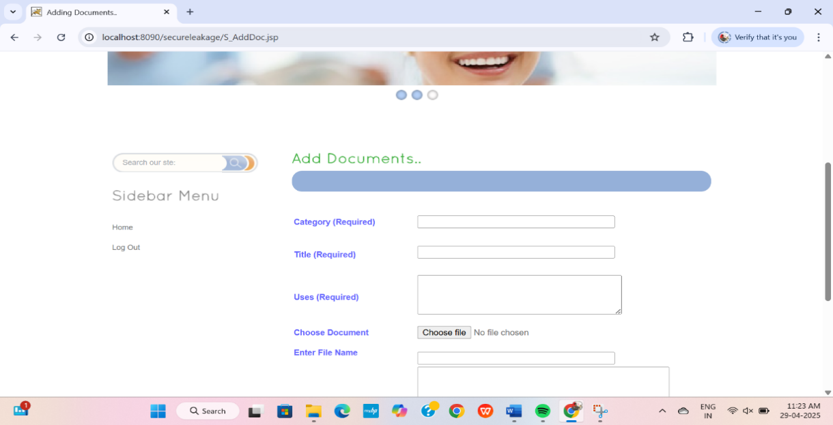
Admin Interface for Adding Documents

Slide 30
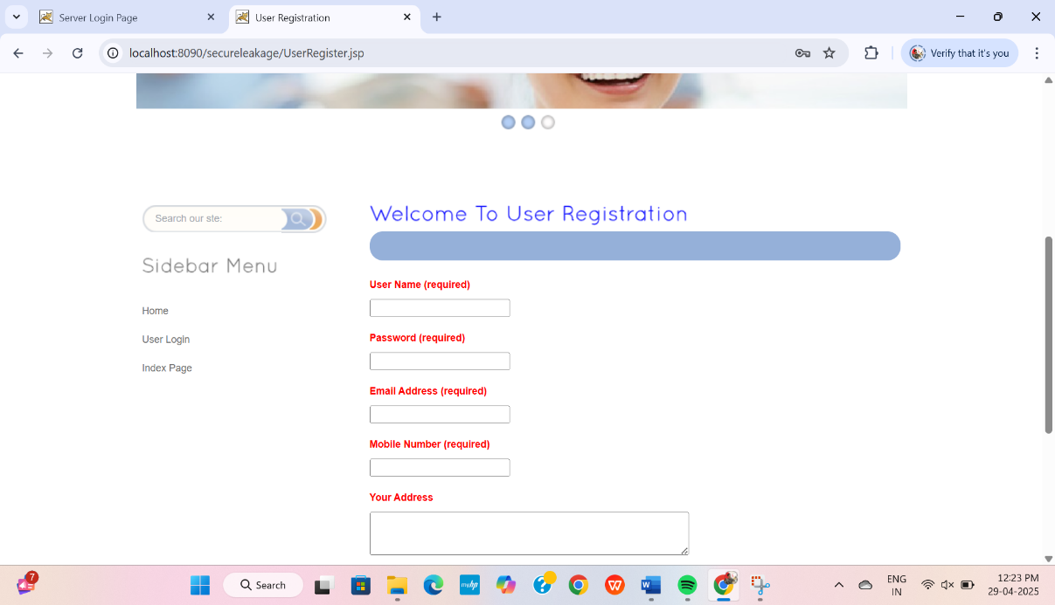
User Registration Page

Slide 31
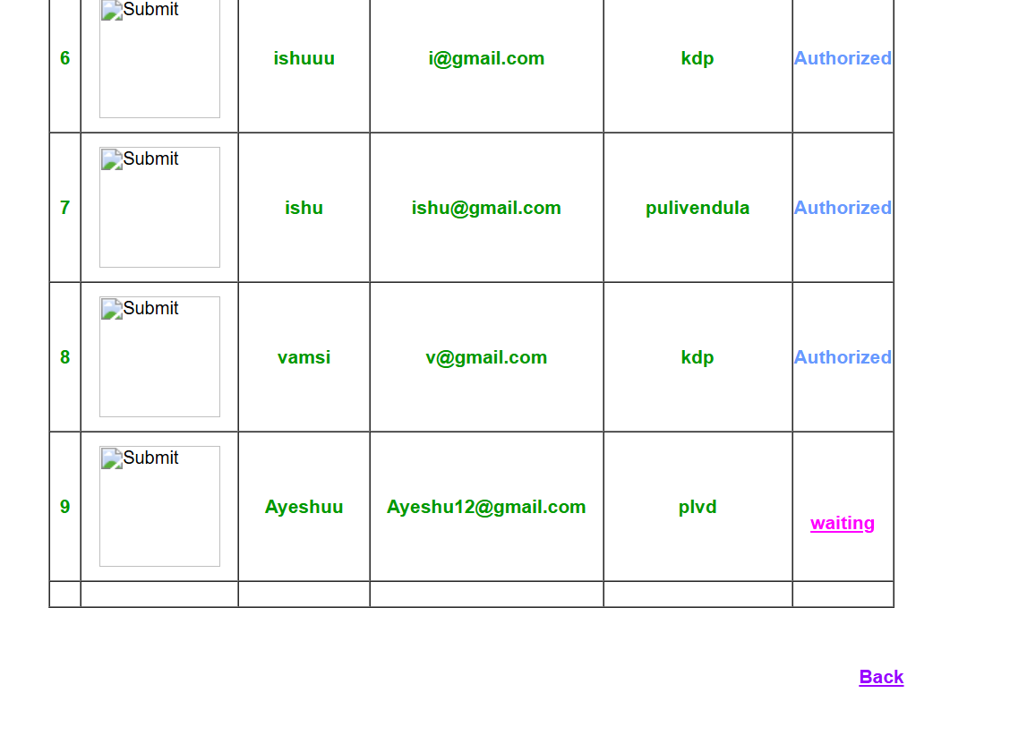
Admin has Authorized a New User

Slide 32
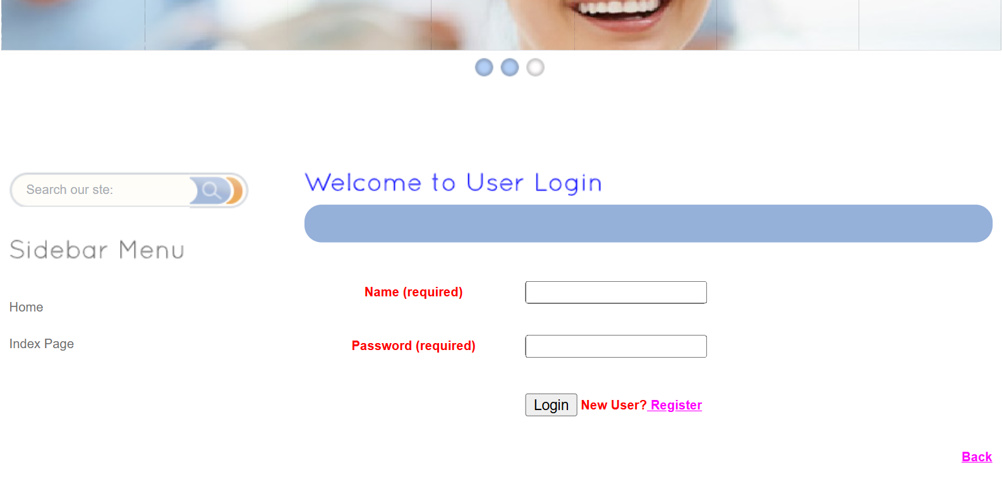
User Login Page

Slide 33
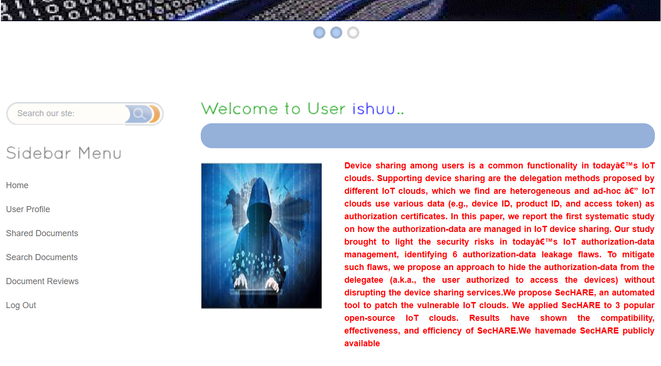
User Dashboard

Slide 34

Attacker Can Attack Data by Using URL

Slide 35
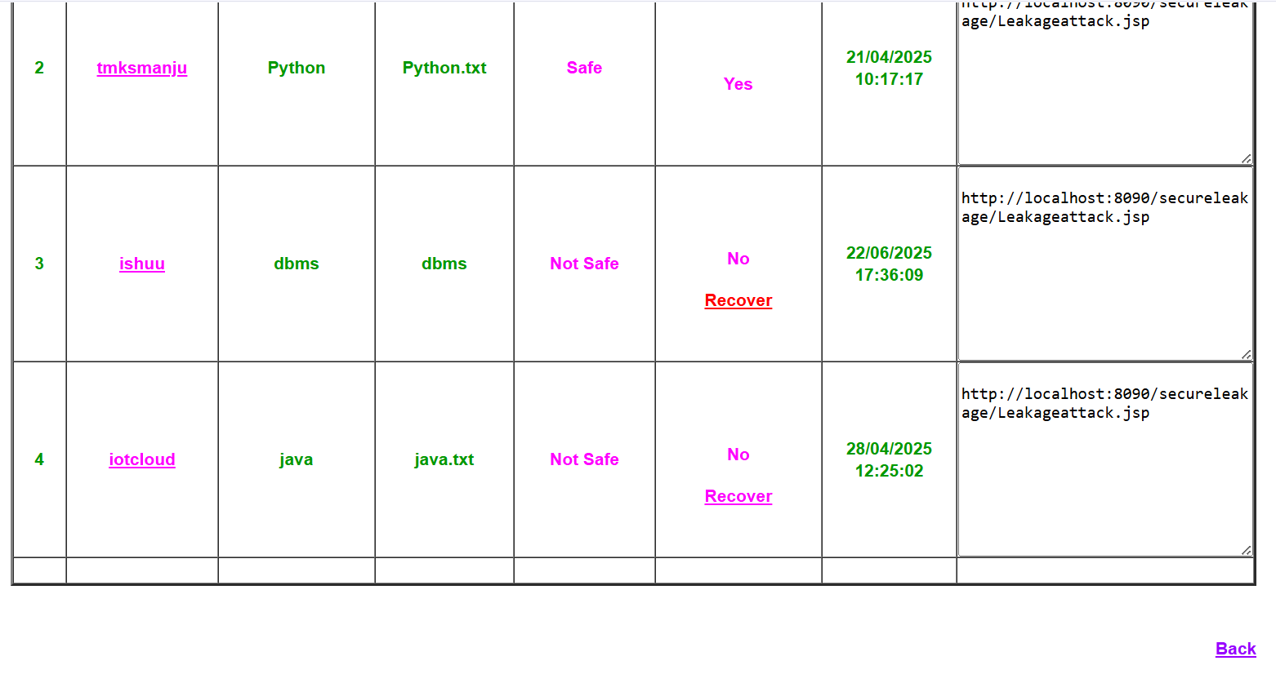
Attacked Documents Recovery

Slide 36
CONCLUSION
Authorization-data leakage in IoT device sharing highlights significant security vulnerabilities that can be exploited by attackers to gain unauthorized access. Various studies have identified multiple attack vectors, emphasizing the importance of robust authorization mechanisms, encryption techniques, and automated security tools such as SecHARE. The effectiveness of these solutions has been demonstrated on opensource IoT cloud platforms, proving their feasibility in real-world applications. However, despite advancements, challenges such as scalability, dynamic access control, and cross-platform security integration remain unresolved.

Slide 37


